Slide 1
Electromagnetism
In the Medical Field

Slide 2
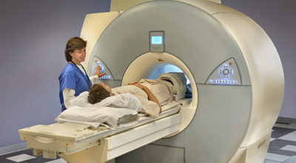
MRI – Magnetic Resonance Imaging

Slide 3
Why they are important
Used to diagnose the following:
  Brain tumors
  Torn ligaments
  Multiple schlerosis
  Strokes
  Tendonitis
  Cancer
  Much much more…

Slide 4
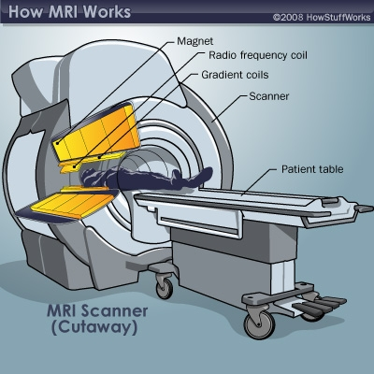
How it works

Slide 5
Magnets are used how?
Superconducting magnet
Cooled wires in a vacuum
Strong magnetic field created for high quality imaging
Resistive magnets
Permanent magnets
Gradient magnets

Slide 6
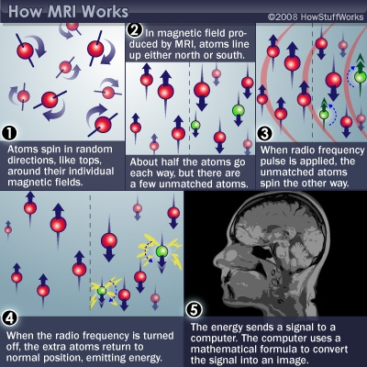

Slide 7
Why fund more research?
We need to find a way to make MRI’s more patient friendly (laying still for long period of time, loud, etc…)
MRI’s are expensive to purchase and to use… Can they be made more cost effective
MRI’s are extremely valuable to doctors and patients for their diagnostic capabilities
More research needs to be done related to patient saftey

